Slide 1
GRAPHIC
DESIGN
R.Rajeshkumar, Assistant Professor
Department of Visual Communication
Jamal Mohamed College (Autonomous), Tiruchirappalli

Slide 2
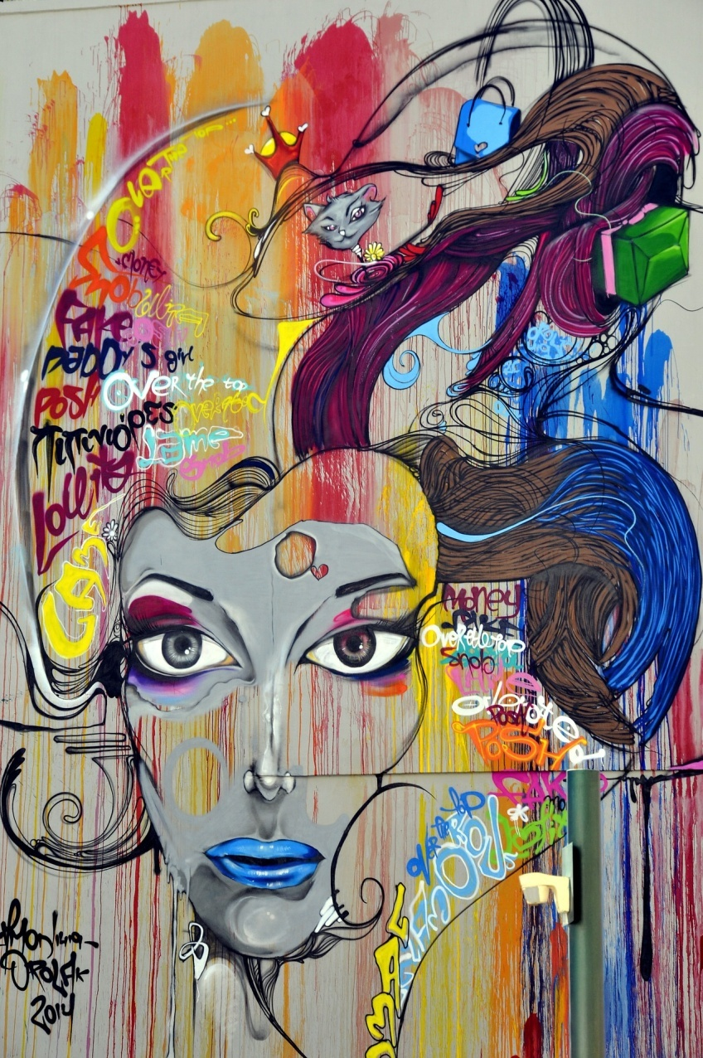
Graphic Design Is The Art
Or Skill Of Combining Text And
Pictures In Advertisements,
Magazines, Or Books

Slide 3
What Is Graphic Design?

Slide 4
Graphic
‘visual’
Art, imagination, expression
Involving Many Mediums Such As
Drawing, Painting, Engraving Or Lettering
Giving Clear And Explicit Detail.

Slide 5
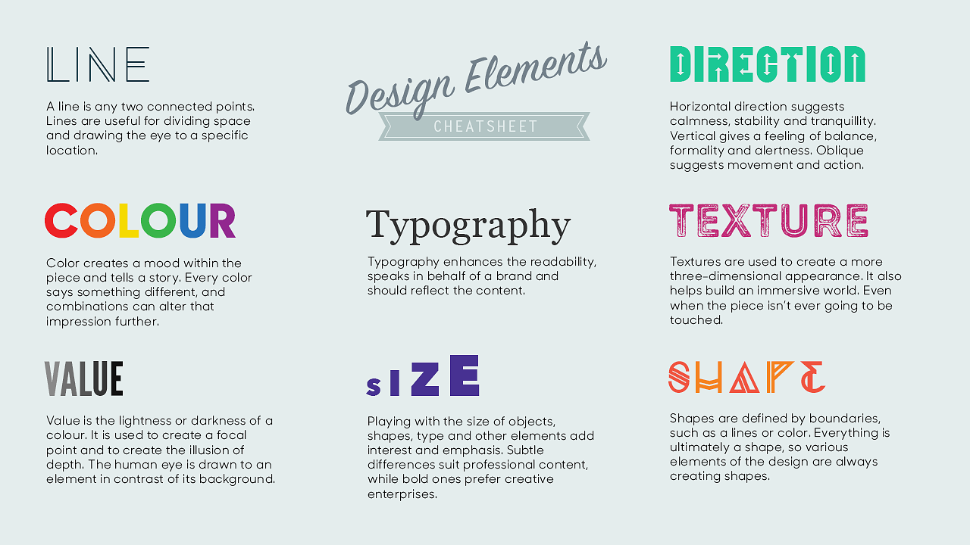
Visual Elements That Combine
To Create Graphic Design
Line, Colour, Shape,
Texture, Space,
Form, Typography

Slide 6
Design
‘To Decide Upon The Look And Function
Of Something Before Its Made’
Thinking, Problem Solving, Practicality
In Graphic Design There Are Rules
That Can Be Considered. These Rules Are
Called The ‘ Principals Of Design’.

Slide 7
Key Principles Of Design
Contrast, Hierarchy, Alignment,
Balance, Proximity,
Repetition, simplicity & Function

Slide 8
Design Principles
Visual Elements

Slide 9
Graphic Design Is:
The ‘Organization’ And
‘Presentation’ Of ‘Information’
Developed Through
A ‘Creative Process’
For A ‘Particular Function’.

Slide 10
Its Only Once We Have A Solid Idea,
Developed Through The
‘Design Process’ We Can Use
Our Skills With Layout, Colour,
Typography And Creative Tools
To Bring That Idea To Life

Slide 11
Advertising
Branding
Web Design
Interface Design
Magazine Layout
Paper Engineering &
Packaging
Tv/ Motion Graphics
Info Graphics
Signage
Art & Installations
Digital Art
Graphic Design Jobs

Slide 12
1st Key Element
Line
Visual Element In Graphic Design

Slide 13
Lines Can Be Used To
Add Structure To A Composition,
To Frame Information
And To Divide Information.

Slide 14
Used Considerately Lines
Can Add Elegance To
A Composition, Add Hierarchy
And To Draw The Eye
To A Specific Point.

Slide 15
Line
Line
Line

Slide 17
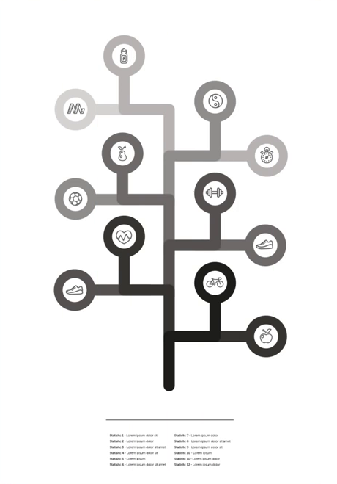
Example 1
Line In Structure

Slide 18
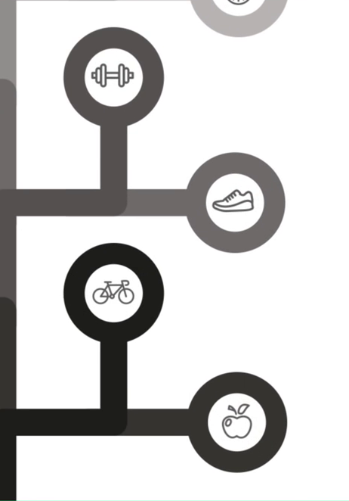
Example 1
Line In Info Graphics

Slide 19
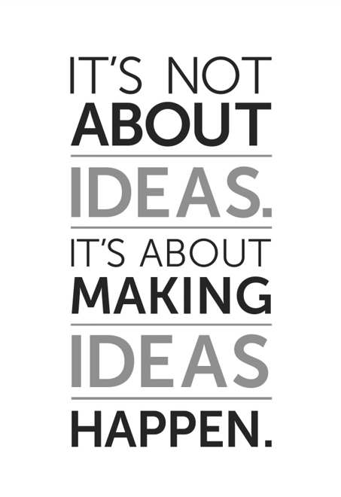
Example 2
Lines stressing a word

Slide 20
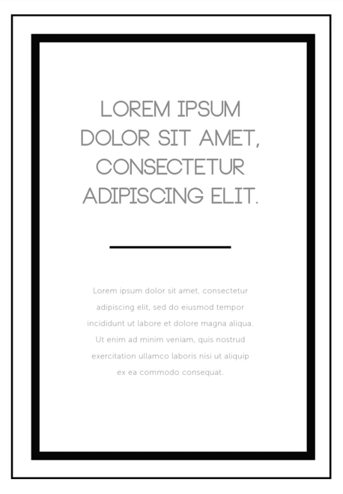
Examples 3
Lines As Borders

Slide 21
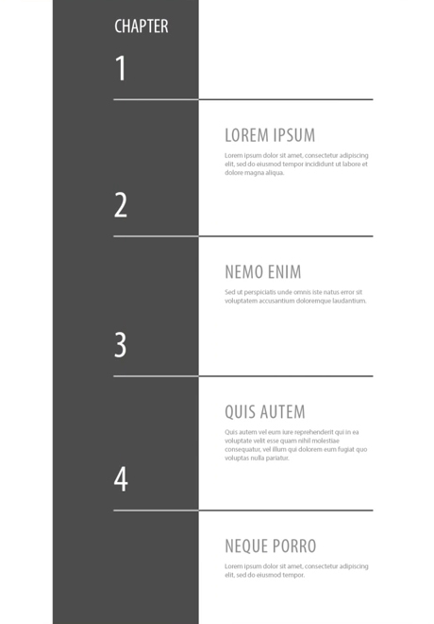
Example 4
Line In Structure

Slide 22
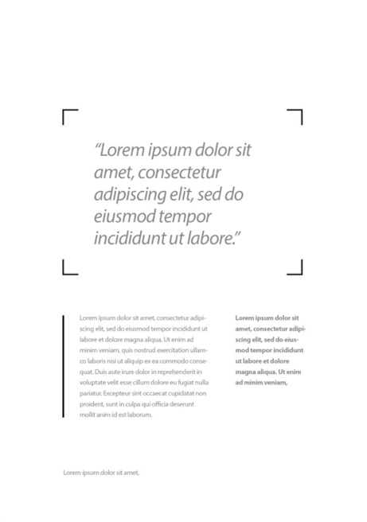
Example 5
Line In Structure

Slide 23
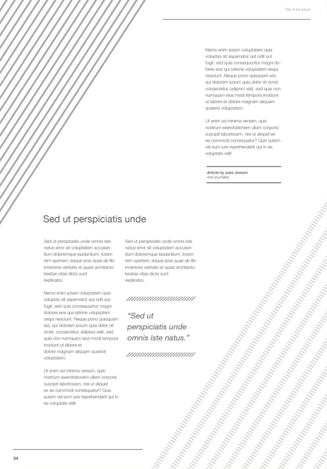
Example 6
Line as decoration

Slide 24
1st Key Element
Colour
Visual Element In Graphic Design

Slide 25
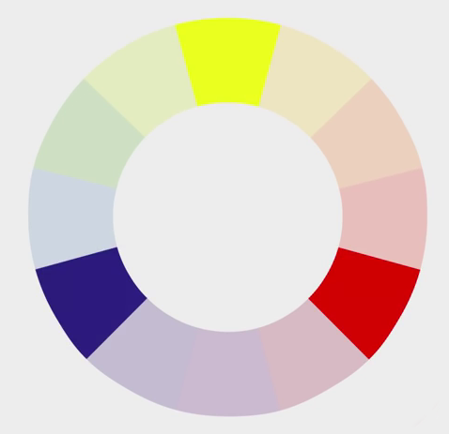
Primary Colours

Slide 26
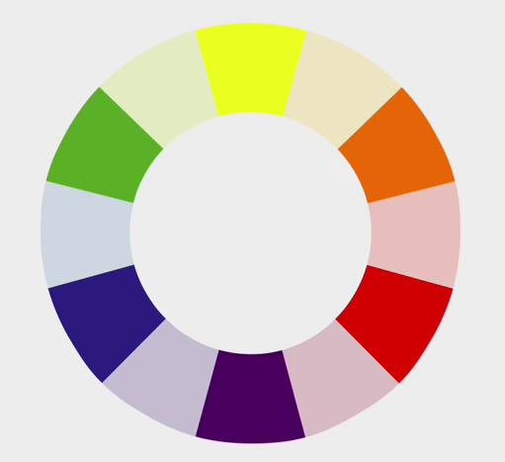
Secondary Colours

Slide 27
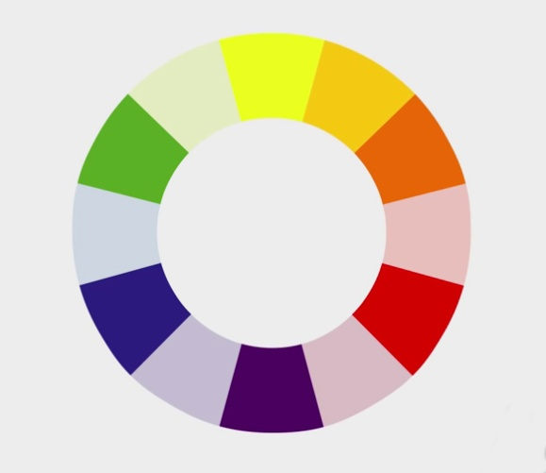
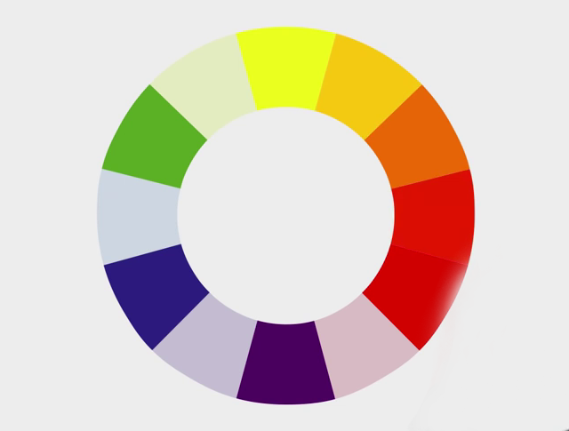
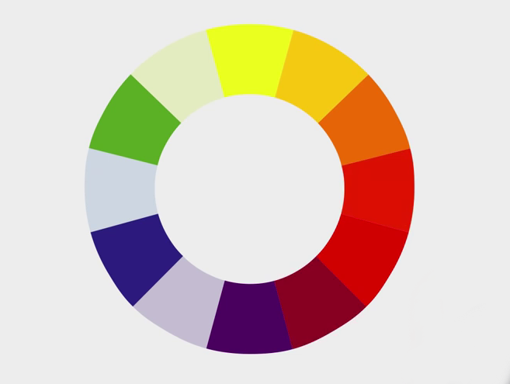
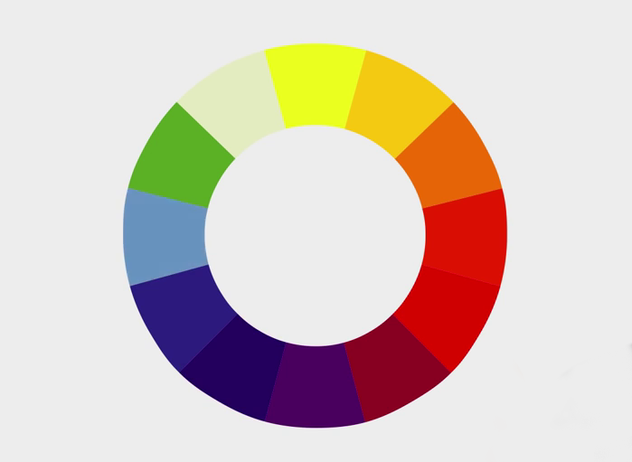
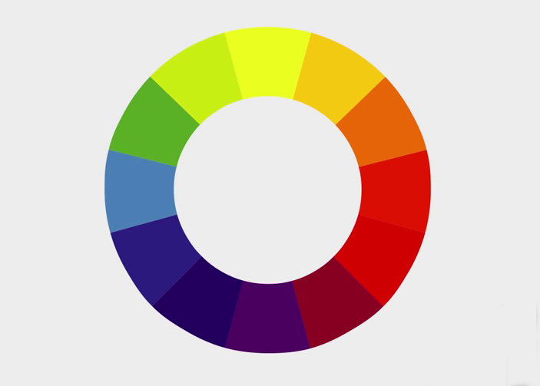
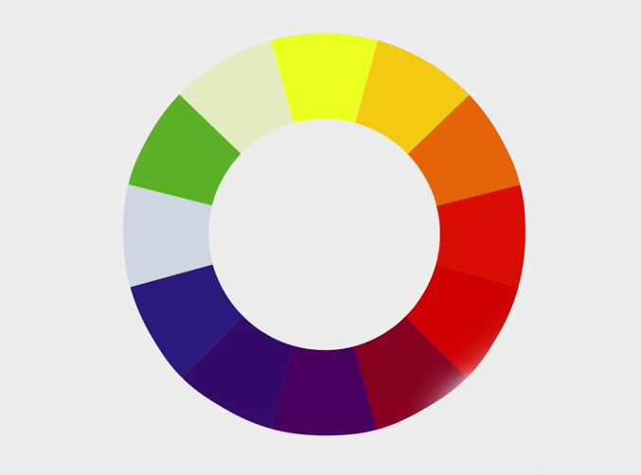
Tertiary Colours

Slide 28
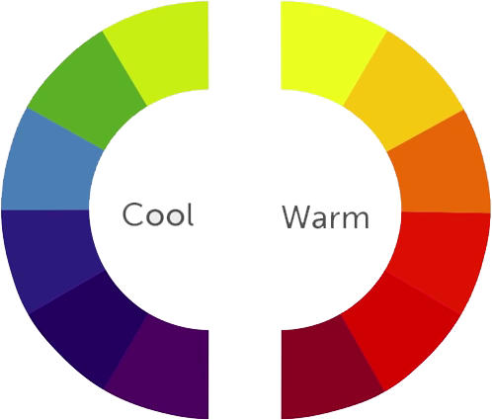

Slide 29
Colour Rules
Monochromatic Colours
Analogous Colours
Complementary Colours
Triadic Colours

Slide 30
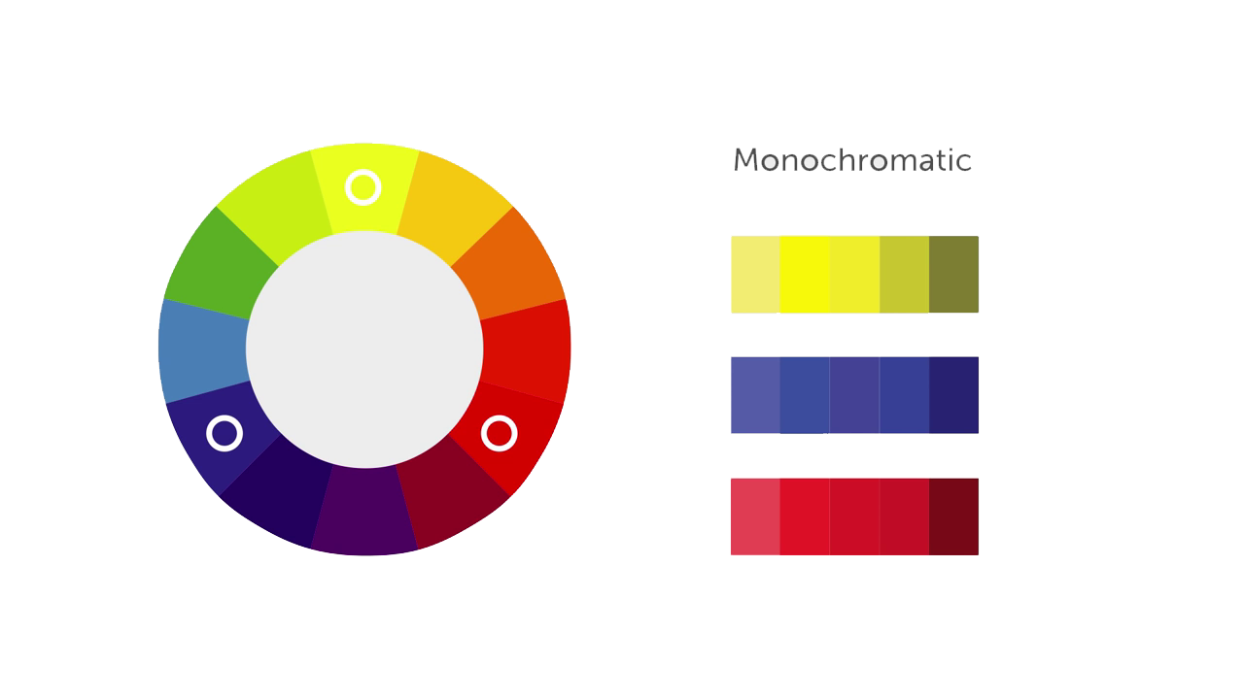
1. Monochromatic Colours

Slide 31
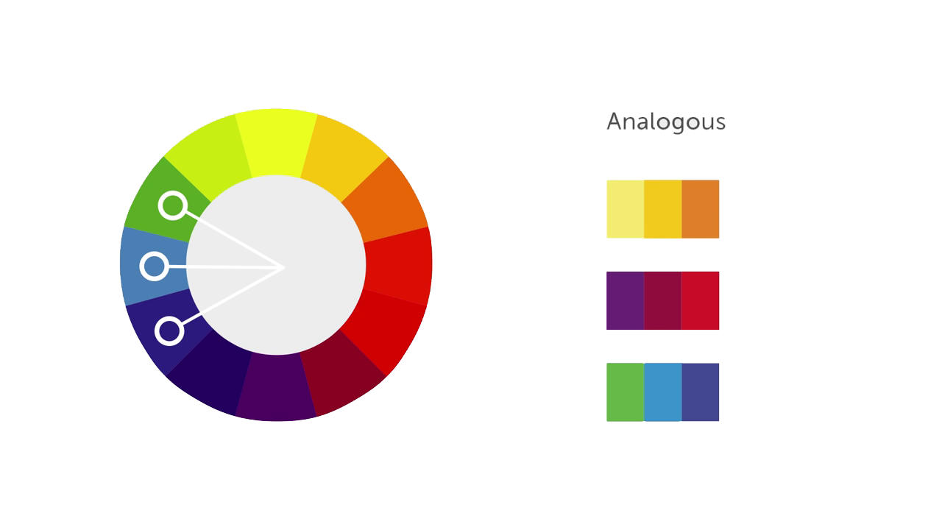
2. Analogous Colours

Slide 32
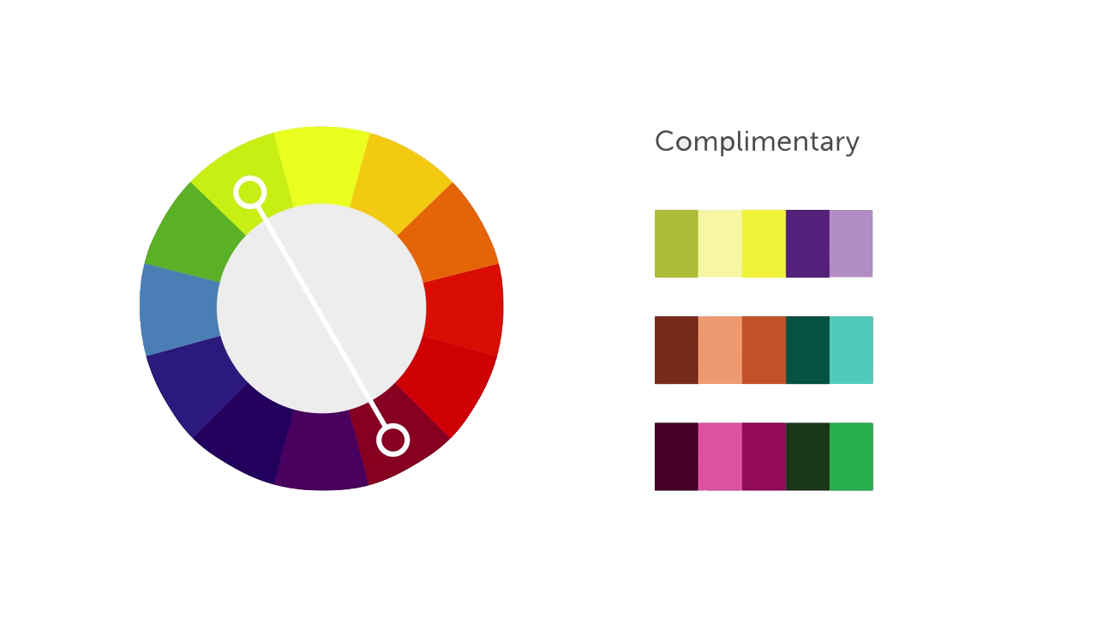
3. Complementary Colours

Slide 33
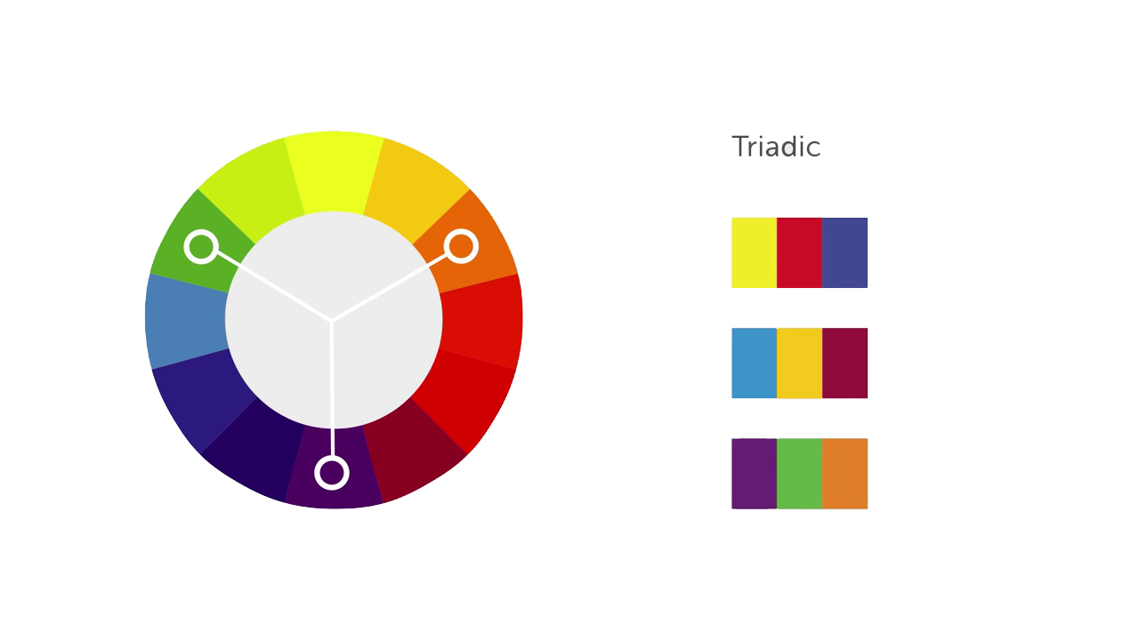
4. Triadic Colours

Slide 34
3rd Key Elements
Shape
Visual Element In Graphic Design

Slide 36
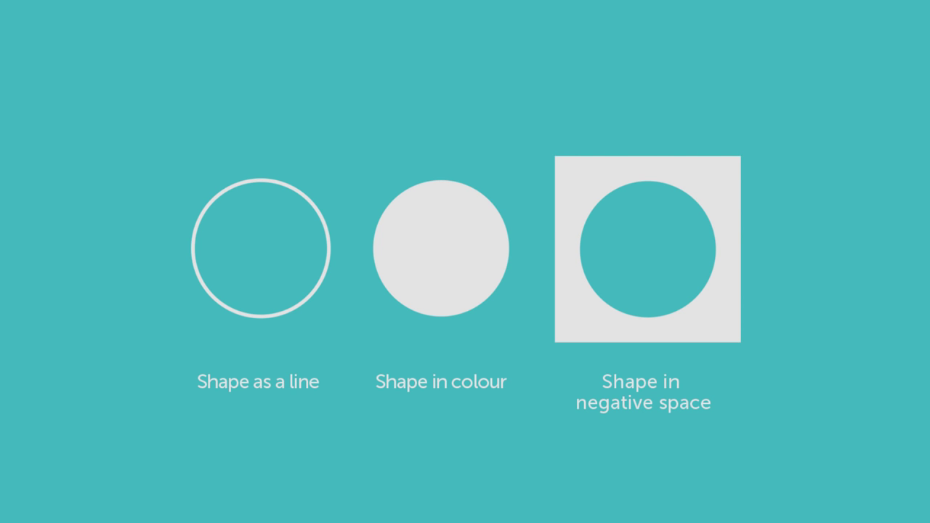

Slide 37
Two types of shapes
Geometric Shapes
Organic Shapes

Slide 38
Geometric Shapes

Slide 39
Organic Shapes

Slide 40
In Design When We Begin To
Place Shapes Together We
Create A Relationship Between Them.

Slide 41
However Simply Or Complex
Its This Relationship Between Shapes
That Can Trigger Feelings,
Convey Messages, Engage An
Audience, Add Emphasis To A Portion
Of A Layout And Create Movement

Slide 45
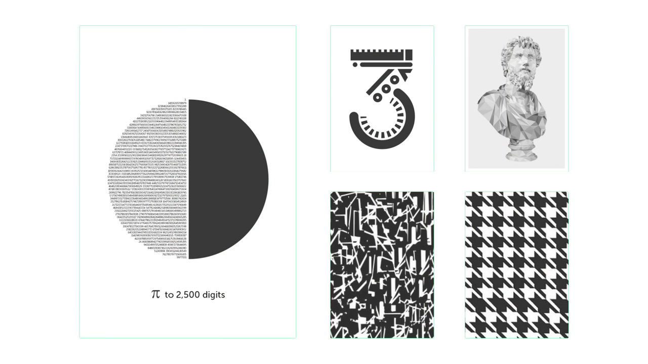

Slide 46
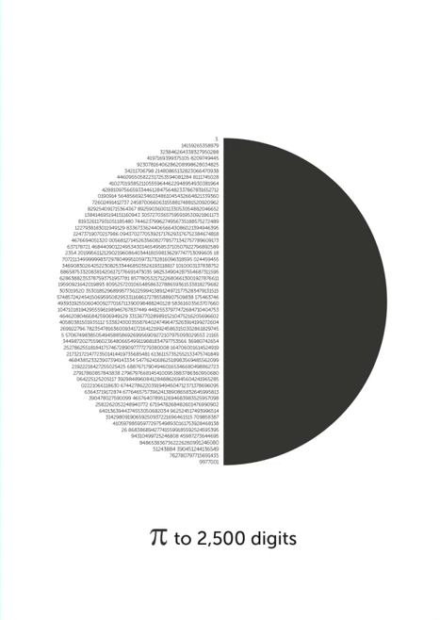
Example 1
Group of individual shapes
Creating an overall shape
In a composition

Slide 47
Example 2
Shape to decorate, to build,
Illustrate and hint at another
Another shape.

Slide 48
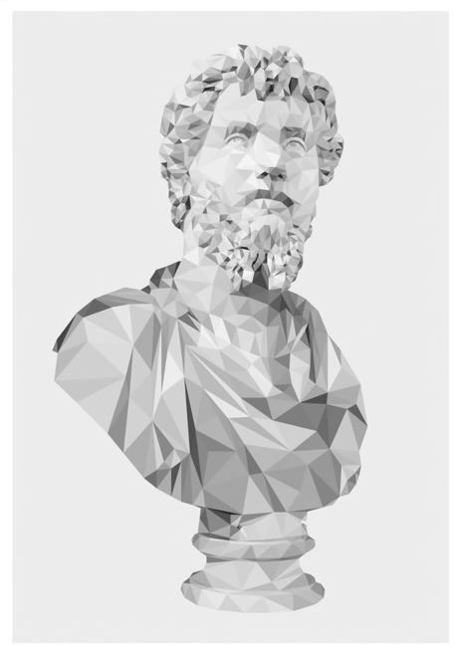
Example 3
Build a legible image
As an illustration.

Slide 49
Example 4
To create a surface
Image texture.

Slide 50
Example 5
To create a surface
Pattern texture.

Slide 51
Visual Elements That Combine
To Create Graphic Design
Line, Colour, Shape,
Texture, Space,
Form & Typography

Slide 52
4th key element
Texture
Visual element in graphic design

Slide 53
Types Of Texture
Image Texture
Pattern Texture

Slide 54
Image Texture
Image Texture Can Be
Environmental
Biological
Man Made

Slide 55
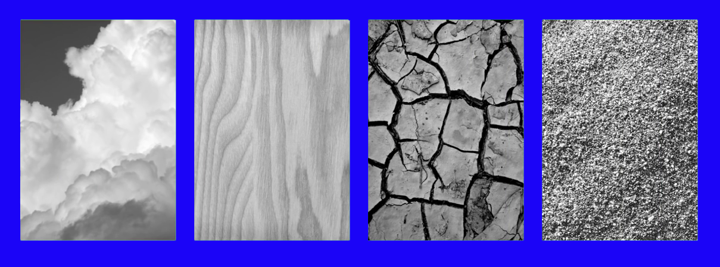
Environmental Image Texture

Slide 56
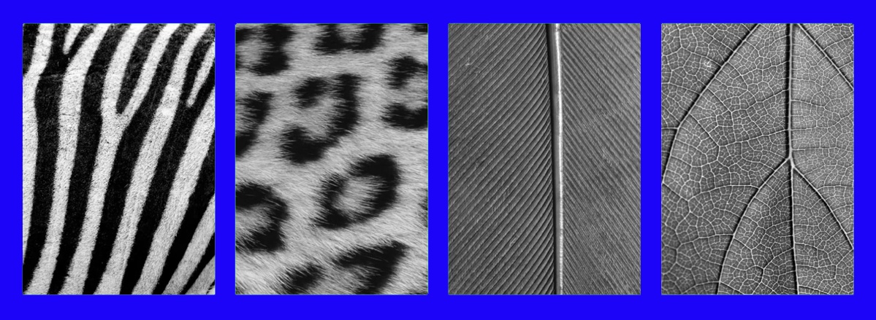
Biological Image Texture

Slide 57
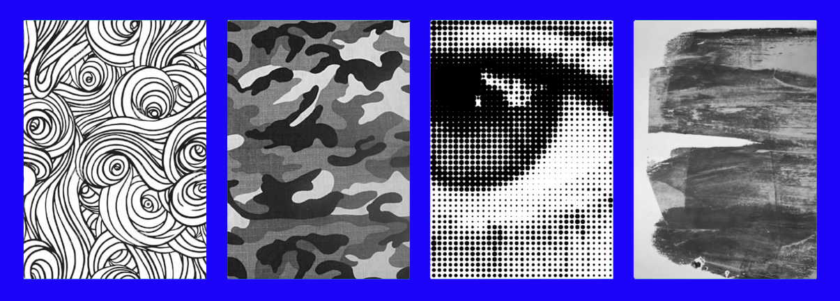
Man Made Image Texture

Slide 58
Pattern texture

Slide 59
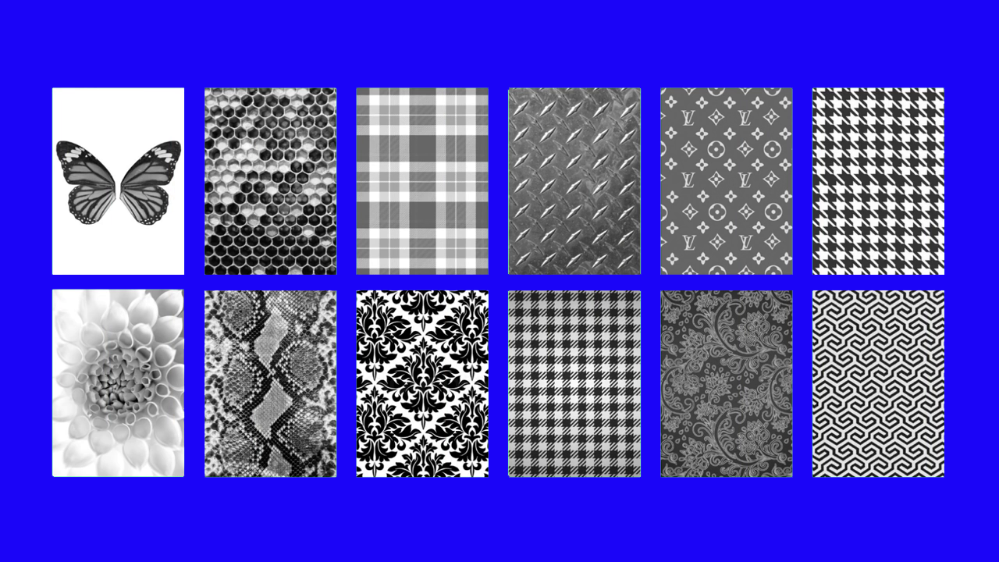

Slide 65
5th Key Element
Space
Visual Element In Graphic Design

Slide 66
Types of space
Positive space
Negative space

Slide 67
Effects Applied To Shapes To Create Dynamics
Proximity
Overlap
Opacity
Light
& Shadow
Perspective

Slide 68
Proximity

Slide 69
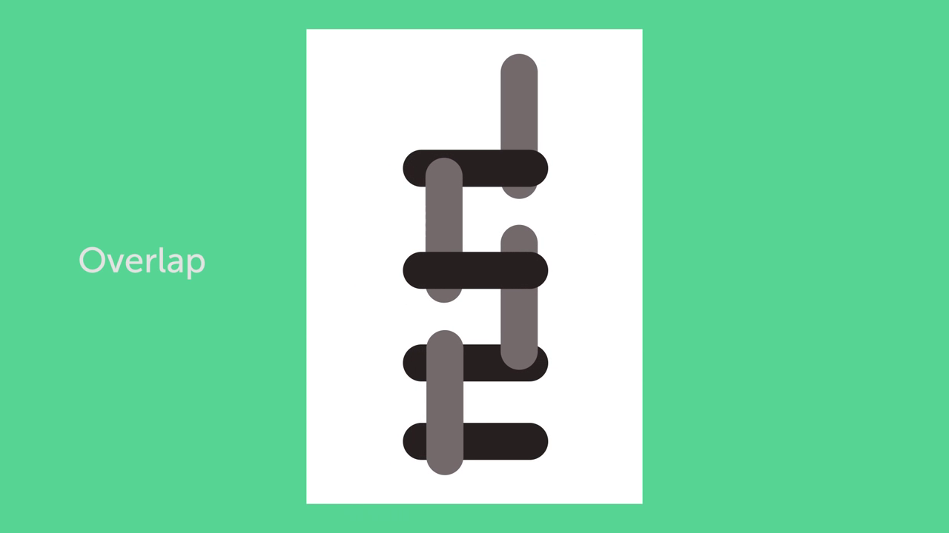
Overlap

Slide 70
Opacity

Slide 71
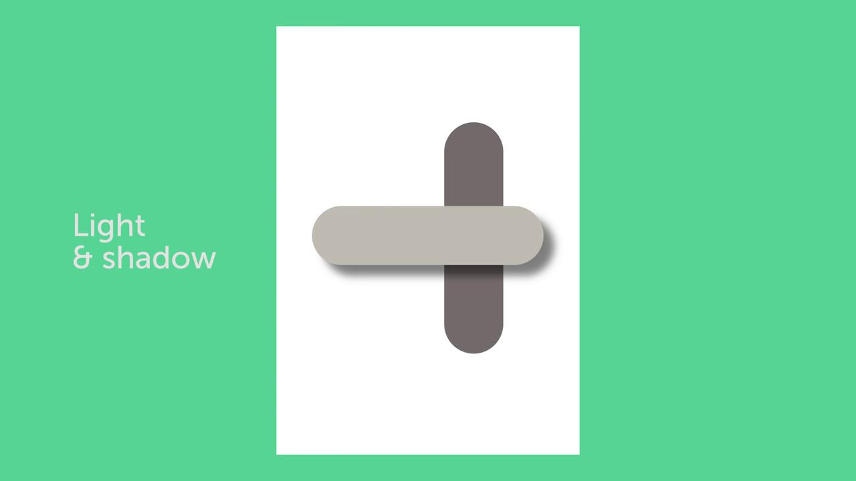
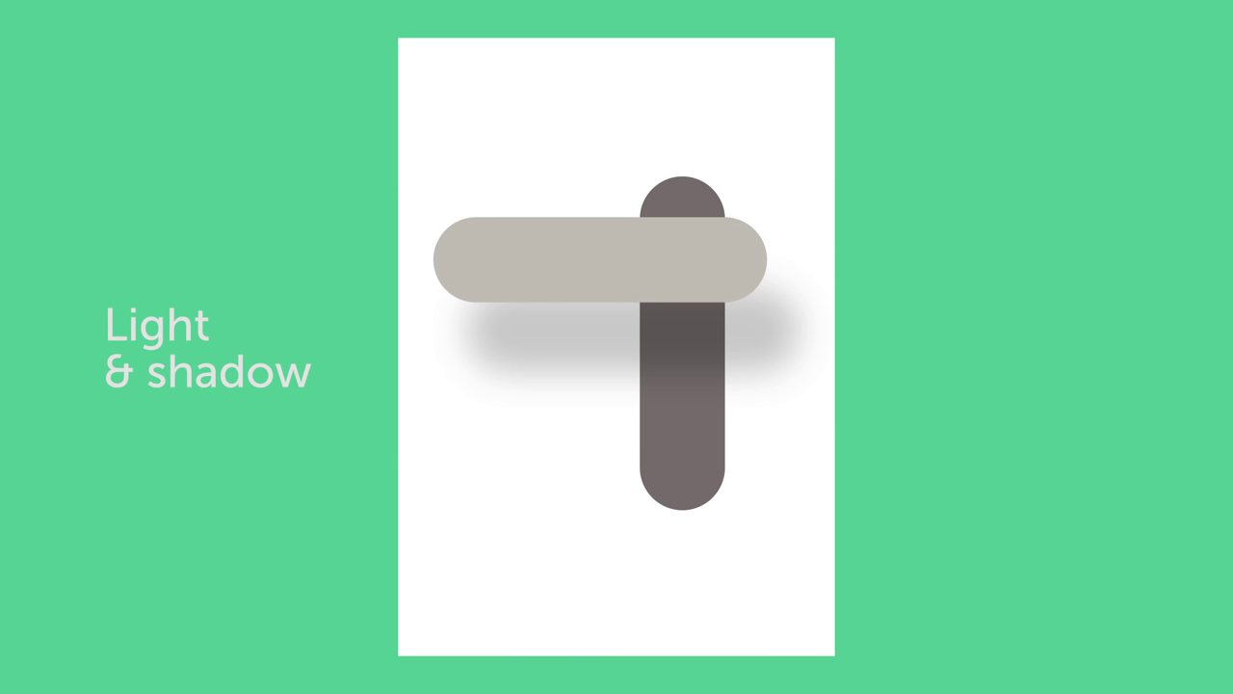
Light & Shadow

Slide 72
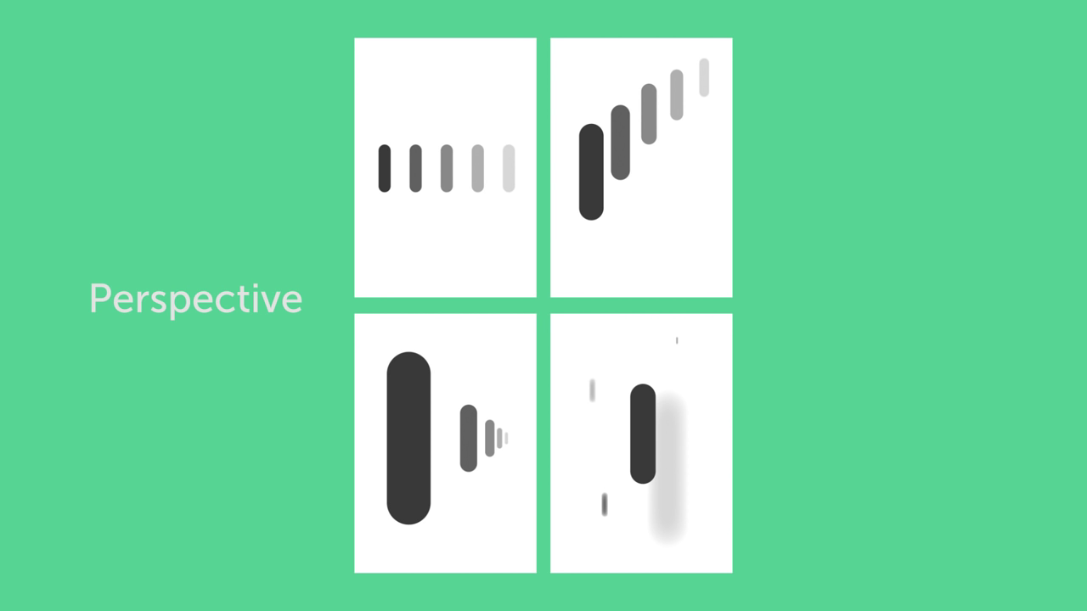
Perspective

Slide 73
6th Key Element
Form
Visual Element In Graphic Design

Slide 76
Because Of This Visual Dynamic,
Form Can Be Used To Create
A Distinct Look And Feel
To A Piece Of Graphic Design Work.

Slide 77
Types of forms
Geometric forms
Organic forms

Slide 78
7th Key Element
Typography
Visual Element In Graphic Design

Slide 82
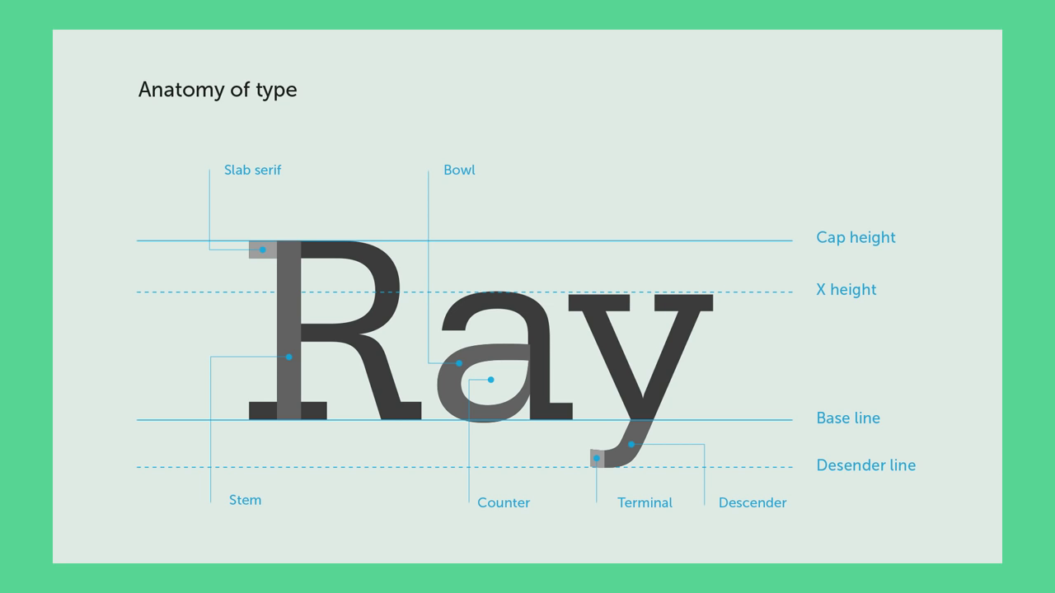

Slide 83
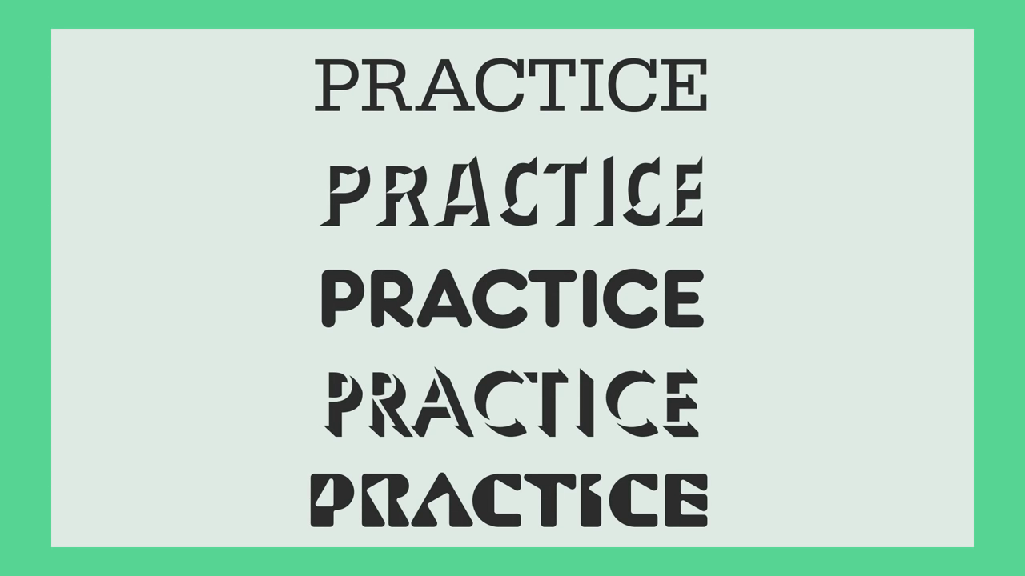

Slide 84
The Choice Of Typeface Used
In A Design Is Crucial
To Set The Intended
Look And Feel, Set A Tone And
Add Character To A Piece Of Work.

Slide 88
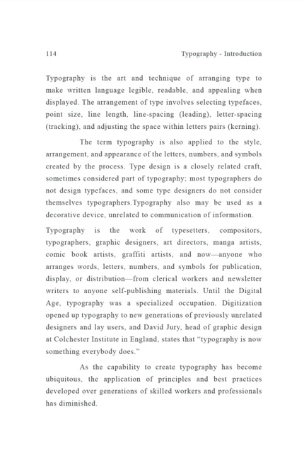
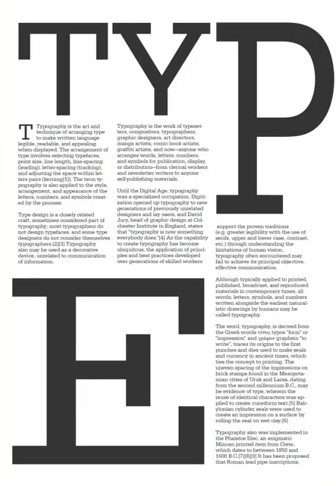

Slide 89
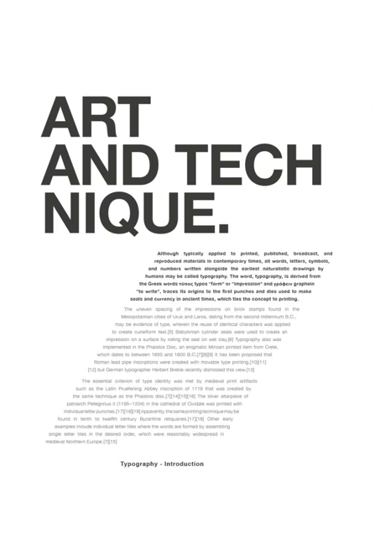
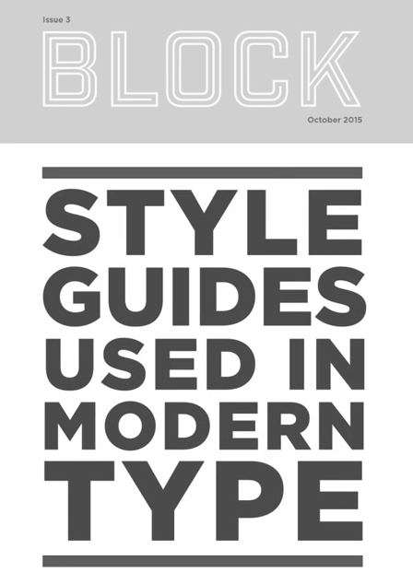

Slide 90
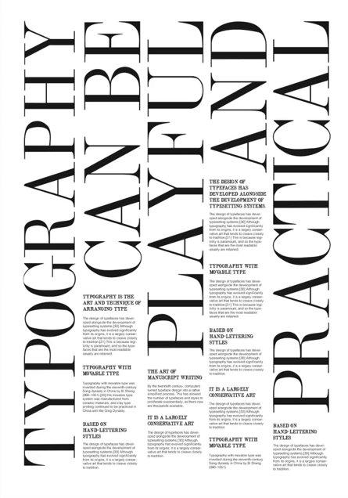

Slide 91
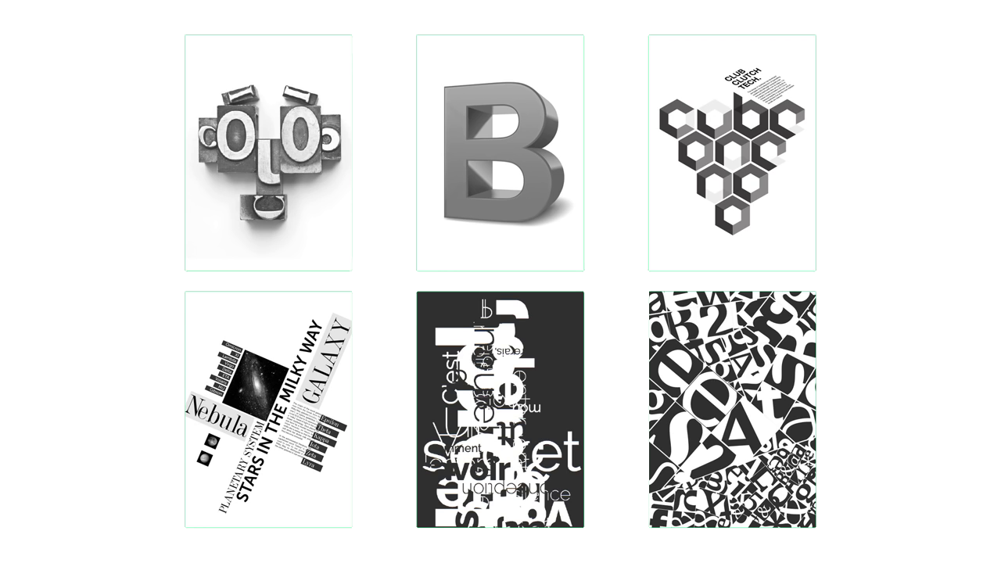

Slide 93
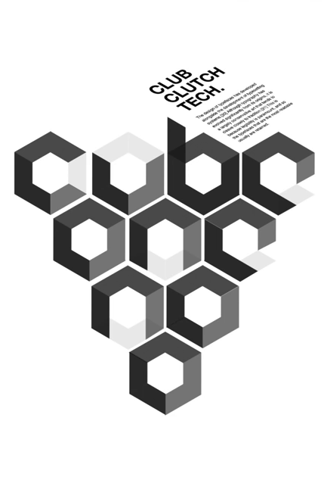
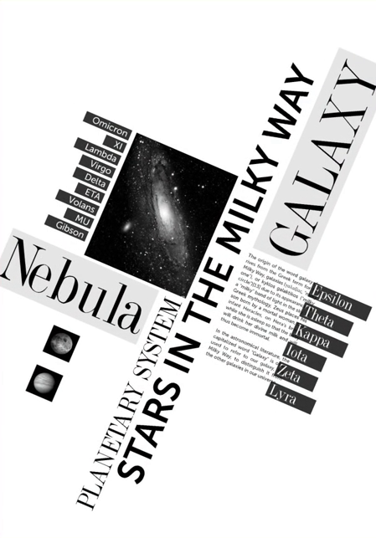

Slide 94
Key Principle Of Graphic Design
Contrast, Hierarchy, Alignment,
Balance, Proximity, Repetition,
Simplicity & Function

Slide 95
1st Key Principle
Contrast
Design Principle In Graphic Design

Slide 96
Now Context Is Integral To Contrast.
We May Think That The Chosen
Visual Object In A Composition
Says Something About Itself.

Slide 97
But It Is More Often
The Visual Elements Around It,
That Give It Its Meaning.

Slide 99
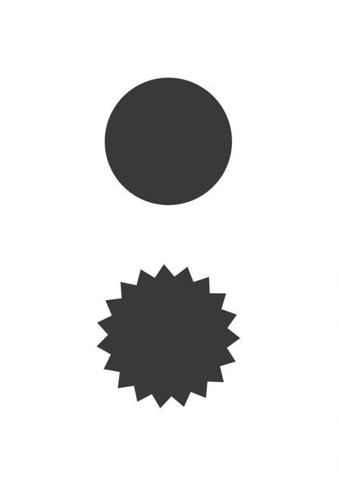
Contract
In Shape

Slide 100
Contract
In Colour

Slide 102
Contract
In Layout

Slide 103
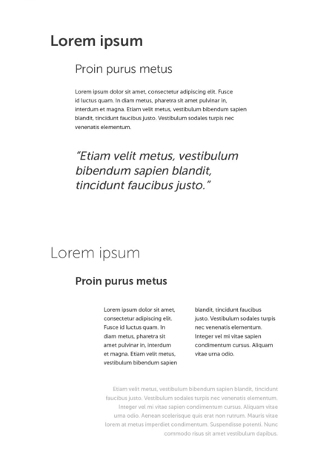
Contract
In Type

Slide 104
Contract
In Colour

Slide 105
Contract
In alignment

Slide 106
Contract
In Colour

Slide 108
2nd Key Principle
Hierarchy
Design Principle In Graphic Design

Slide 109
Hierarchy is typically created
By contrast between visual
Elements in a composition.
Typically visual elements with
Highest contrast are noticed first.

Slide 111
Hierarchy
In Scale

Slide 112
Hierarchy
In Colour

Slide 113
Hierarchy
In Scale

Slide 114
Hierarchy
In Colour

Slide 115
Hierarchy
In Colour

Slide 117
Hierarchy
In Depth

Slide 120
Examples

Slide 124
3rd Key Principle
Alignment
Design Principle In Graphic Design

Slide 125
Two Alignment Principles
Edge Alignment
Centre Alignment

Slide 126
Edge Alignment
Centre Alignment

Slide 127
Alignment Can Be Used To Achieve
A Particular Look And Feel.
One Should Always Be Conscious When
Working With Alignment
To Achieve The Intended Result.

Slide 129
In Design One Should Try And
Avoid The Appearance Offing Having
Made Arbitrary Decisions.

Slide 130
When Visual Elements Are Out
Of Align It Is Noticeable,
And Can Devalue A Piece Of
Work If Done Unintentionally.

Slide 134
Key Principle Of
Graphic Design
Contrast, Hierarchy,
Alignment, Balance,
Proximity, Repetition,
Simplicity & Function

Slide 135
4th key principle
Balance
Design principle in graphic design

Slide 136
In Design One Will Attempt To Place
Visual Elements In An Aesthetically
Pleasing Arrangement, Or Particular
Arrangement To Fulfill A Purpose Or
Achieve A Particular Look And Feel

Slide 137
1. Symmetrical Balance
(Formal)
THREE
MAIN
TYPES
OF
BALANCE
2. Asymmetrical Balance (Informal)
3. Radial Balance

Slide 139
5th Key Principle
Proximity
Design In Graphic Design

Slide 140
In Design Related Elements Should
Be Grouped Together So That
They Will Be Viewed As A Group.

Slide 141
Unrelated Elements Should Have
Distance And Should Not Be
In Close Proximity To Each Other.

Slide 142
Audiences Will Assume
That Elements That Are Not Near
Each Other In A Design
Are Not Closely Related.

Slide 143
Example 1
Adequate Relationships
Are Established In
This Layout. Elements In
A Comprehensive Order.

Slide 144
Example 2
Clear Relationships Are
Established In This Layout.
Elements Are In Close
Proximity In A Clear Order.

Slide 145
Example 3
Elements Are In Close
Proximity But In No
Particular Order Creating
A Random And
Confusing Layout.

Slide 146
Example 4
Elements Are Scattered
In A Sporadic Layout.
No Clear Relationship
Between Element
In This Layout.

Slide 147
In Design One Should Try And
Avoid The Appearance Of
Having Made Arbitrary Decisions.

Slide 148
When Visual Elements
Appear Randomly Or Poorly
Positioned, It Is Noticeable,
And Can Devalue A Piece
Of Work If Done Unintentionally.

Slide 150
When We Think Of All The Symbols,
And Logos We Know So Well.
Its Through The Combination Of
Shapes And Proximity That Works
To Imprint Images Into Our Memory

Slide 152
However Simple Or Complex Its This
Relationship Or Lack Of Relationship
Between Shapes That Can
Trigger Feelings, Convey Messages,
Engage An Audience,
Add Emphasis To A Portion
Of A Layout And Create Dynamics.

Slide 153
6th Key Principle
Repetition
Design Principle In Graphic Design

Slide 154
Good Design Practice,
Seeks To Repeat Some Aspects
Of A Design Throughout
A Piece Of Work, Be It For
A Simple Or Complex Piece Of Work.

Slide 155
The Ultimate Goal
Of Any Piece Graphic Design
Is To Make An Impression,
Hopefully A Lasting Impression.

Slide 156
If A Design Achieves This Goal,
It Will Be Fulfilling Its Purpose,
To Communicate And Insist Upon
A Particular Message, Which
Lingers And Becomes Familiar.

Slide 157
This Is A Carefully Orchestrated
Design To Create A Noticeable
And Memorable Look And Feel.

Slide 158
It Is Valuable To Any Business
That Their Brand Is
Impressionable And Memorable.

Slide 159
7th key principle
Simplicity
Design principle in graphic design

Slide 160
The Ultimate Goal Of Any Piece Of Graphic Design Is To Make An
Impression, Hopefully A Lasting
Impression, If A Design Achieves
This Goal, It Will Be Fulfilling Its Purpose, To Communicate
And Insist Upon A Particular Message.

Slide 161
When Applying Simplicity
In Design We Should
Avoid An Overwhelming
Amount Of Visual Elements.

Slide 162
We Should Try And Get
Across One Strong Idea Instead
Of Incorporating Many.

Slide 163
When Considering Simplicity
We Should Remove
Or Edit Down Information
And Details That Are Not Needed

Slide 164
When You Think Of Some
Of The Most, Prestigious Brands,
Its Common To See:
Simplicity Set On A Backdrop
Of Complex Beauty.

Slide 165
8th key principle
Function
Design principle in graphic design

Slide 166
The Ultimate Goal Of Any
Graphic Design Is To Communicate
And Make An Impression, But What’s
Equally Important Is That The
Right Impression Is Made And The
Intended Outcome Is Achieved.

Slide 167
Typical Design Brief
The Overview
Typical Design Brief
The Requirements
Typical Design Brief
The Intended Outcome

